Slide 1
CSCE 1035 Computer Programming I Chapter 9 Classes
University of North Texas

Slide 2

9.1 Classes: Introduction

Slide 3

Object Basics
Python supports many different kinds of data
1234 3.14159 'Hello' [2, 3, 5, 7, 11, 13]
{'TX': 'Texas', 'LA': 'Louisiana'}
All of these are objects, and every object has a type
An internal data representation (primitive or composite)
A set of methods for interaction with the object
An object is an instance of a type
1234 is an instance of an int
'hello' is an instance of a string
Python automatically creates built-in objects for programmer to use
Including basic data types like integers and strings

Slide 4
Abstract Data Types and Objects
Abstraction
A definition that captures general characteristics without details
An abstract triangle is a 3-sided polygon, but it may be scalene, isosceles, equilateral, etc.
Data Type
Defines the kind of values that can be stored and the operations that can be performed on it
The user of an abstract data type (ADT) does not need to know any implementation details
Such as how the data is stored or how operations on it are carried out
Object-oriented programming is based on objects that encapsulate the data and the functions that operate on it

Slide 5
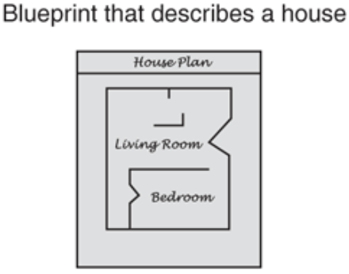
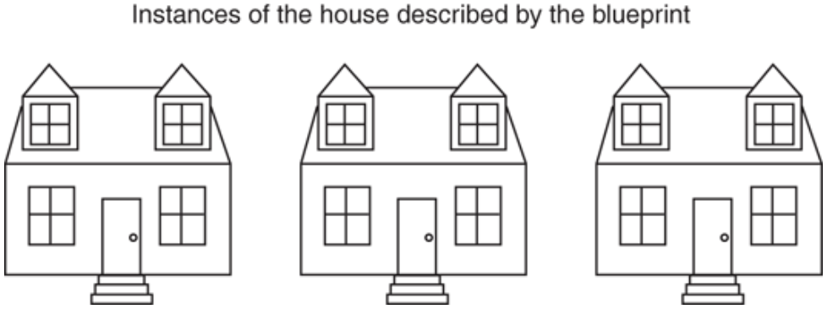
What are Objects?
Objects are a data abstraction that capture
A grouping of data attributes (i.e., member variables)
Behaviors that can be performed on that data (i.e., methods)
Define operations, but hide implementation from user
Classes
Encapsulate data (attributes)
Encapsulate functions (behaviors)
Act as blueprints
Objects are instantiated from classes
Implement information hiding
We can say that the attributes and behaviors are encapsulated into an object

Slide 6
9.2 Classes: Grouping Data

Slide 7
Class Declaration
A class is a special data type that defines how to build a certain kind of object
Instances are objects that are created which follow the definition given inside the class
Defining a class
class header
Keyword class begins definition
Followed by name of class and colon :
Body of class
Indented block of code
Documentation string (optional)
Describes the class
Appears immediately after class header
Python does not use separate class interface definitions as in some languages – you just define the class and then use it
class ClassName:
<statement1>
<statement2>
…
<statementN>

Slide 8
Constructors
All classes in Python has a special method called a constructor that is automatically invoked when a new object is created
Initializes attributes of the class
Returns None
The constructor method is called __init__()
class ClassName:
def __init__(self, [other parameters]):
body of __init__ constructor
…
class Rectangle:
def __init__(self):
self.width = 0
self.length = 0
All methods, including the constructor, must at least specify the self parameter that represents the object reference of the class

Slide 9
Instantiating Objects
To create an instance of a class, you call the class using the name of the class and pass arguments accepted by the __init__() method
Although you must specify self explicitly when defining a method, you do not include it when calling the method
Example
class Rectangle:
def __init__(self):
self.width = 0
self.length = 0
…
shape1 = Rectangle()
shape1.width = 5
print(shape1.width)
Assigns address of object into reference
shape1 = Rectangle()
Creates
reference
variable
Calls constructor
and creates an
object
Once instantiated, you can access the object attributes using the dot operator

Slide 10
9.3 Instance Methods

Slide 11
Class Methods
Define class methods by including function definitions within the scope of the class block
When you define a function inside a class, it is a method
Every instance method must have special first parameter called self
The self parameter provides a way for a method to refer to the object itself
Example
class Rectangle:
…
def print_attrs(self):
print(self.width, self.length)
shape1 = Rectangle()
shape1.print_attrs()
Every method in a class must have self as its first parameter
Every attribute in a class must be prefaced with self upon accessing it

Slide 12
Accessors and Mutators
Access methods allow data of the class to be read and written in a controlled manner
Accessors (i.e., get methods) are methods that return an attribute
def get_name(self):
return self.name
Mutators (i.e., set methods) modify the data members
def set_name(self, new_name):
self.name = new_name
Can validate data to ensure attribute maintains supported value
Accessors and mutators are a useful coding convention to provide data encapsulation
They hide the internal structure of your class and should be used

Slide 13
9.4 Class and Instance Object Types

Slide 14
Class and Instance Attributes
class attributes
Defined within a class definition, but outside any method
An assignment statement in the class, but outside any method creates a class attribute
It is an attribute of the class, not an object, so it represents class-wide information (i.e., one value for all class instances)
Considered to be static variables in some languages
Access by ClassName.name or self.__class__.name notation
Instance attributes
Associated with a particular instance of a class
Created and initialized by the __init__() constructor
Each instance has its own value for it
Access by object.name or self.name notation

Slide 15
Class and Instance Attribute Example
>>> class Sample:
... x = 5
... def __init__(self):
... self.x = 0
... def incr(self):
... self.x += 1
...
>>> a = Sample()
>>> print(a.x)
0
>>> print(Sample.x)
5
>>> print(a.__class__.x)
5
>>> a.incr()
>>> print(a.x)
1
>>> print(Sample.x)
5
>>> Sample.x += 1
>>> print(Sample.x)
6
Since all instances of a class share one copy of a class attribute, when any instance changes it, the value is changed for all instances
>>> b = Sample()
>>> print(b.__class__.x)
6
>>> print(b.x)
0

Slide 16
9.6 Class Constructors

Slide 17
Customizing Constructors
The __init__() constructor can be customized with additional parameters
You can even specify default values as done with functions
Example
class Rectangle:
def __init__(self, width = 0, length = 0):
self.width = width
self.length = length
a = Rectangle()
print(a.width, a.length)
b = Rectangle(5, 8)
print(b.width, b.length)
c = Rectangle(4)
print(c.width, c.length)
Default values
You can realize the importance of the self parameter here

Slide 18
9.7 Class Interfaces

Slide 19
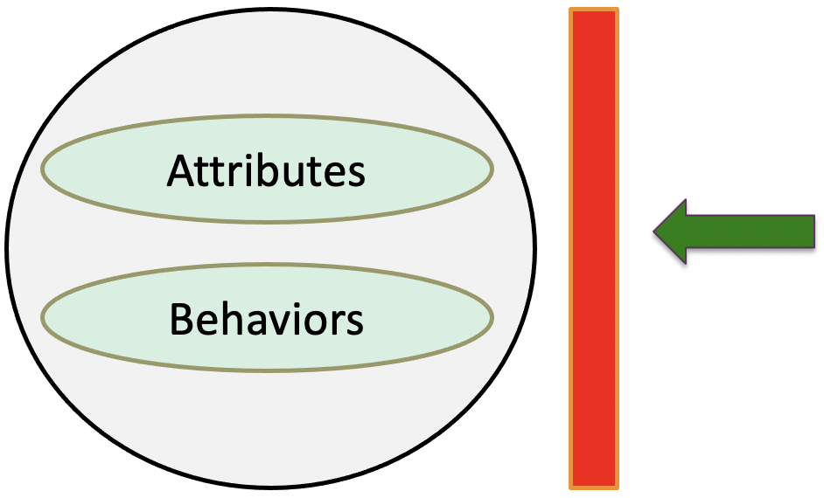
Implementing Abstraction
Can we enforce the use of accessors and mutators?
So, does Python support "private" instance variables?
Yes (and no)
Python attributes and methods are made public by default
Public attributes: any other class/function can see and change attribute
Public methods: any other class or function can call the method
User of object "sees" the abstract version of the object through the public interface

Slide 20
Implementing Public/Private Interface
Python allows a class to prevent client from accessing data directly using attribute naming conventions to hide data
Attributes that are not to be accessed directly are preceded with a single underscore _
You can still access and modify attributes directly, but you are not supposed to
Private attributes with a double underscore __ are not to be modified by users
You can still access the attribute directly, but you must use a mutator to modify the attribute
Similarly, methods can be made private by prepending the double underscore __ to the method name
Private methods can (almost) only be called by other methods defined in the class

Slide 21
9.8 Class Customization

Slide 22
Class Customization
To customize class, implement instance methods with special method names that Python interpreter recognizes
https://docs.python.org/3/reference/datamodel.html
Python allows you to override standard methods which are given by the double underscore and trailing underscores called magic names, such as __init__
They come in three general classes
Numeric type operations (+, -, <, >, etc.)
Container operations ([], iterate, len, etc.)
General operations (printing, construction, etc.)
>>> shape1 = Rectangle()
>>> dir(shape1)
['__class__', '__delattr__', '__dict__', '__dir__’, …
'__subclasshook__', '__weakref__', 'length', 'width']
Many methods left out for space reasons

Slide 23
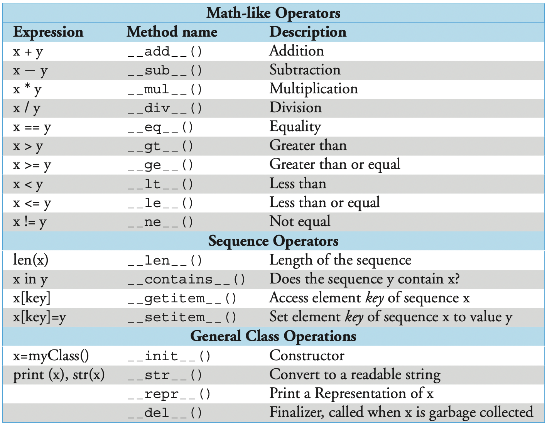
Class Customization

Slide 24
Class Customization
The special __str__() method can be overridden to change how a class instance object is printed
>>> shape1 = Rectangle()
>>> print(shape1)
<__main__.Rectangle object at 0xb78a384c>
Override __str__() in Rectangle class
def __str__(self):
... return self.name + ': width = ' + str(self.width) + \
... ' length = ' + str(self.length)
...
>>> shape1 = Rectangle('shape1', 5, 8)
>>> print(shape1)
shape1: width = 5 length = 8
Default
__str__() must return a string

Slide 25
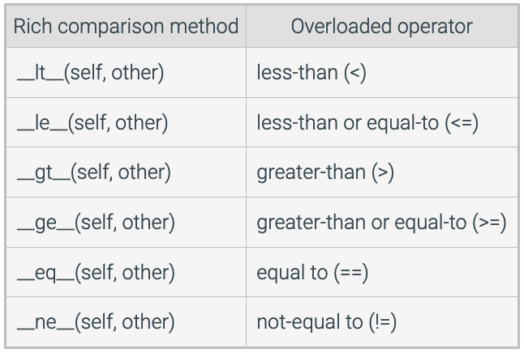
Relational Operator Overloading
Class customization can redefine the functionality of built-in relational operators like > and >= when used with class instances through operator overloading called rich comparison methods

Slide 26
Operator Overloading Example
>>> class Rectangle:
... def __init__(self, width, length):
... self.width = width
... self.length = length
... def __gt__(self, other):
... if self.width * self.length > other.width * other.length:
... return True
... else:
... return False
...
>>> shape1 = Rectangle(5, 8)
>>> shape2 = Rectangle(6, 7)
>>> if shape1 > shape2:
... print('shape1 area > shape2 area')
... else:
... print('shape2 area > shape1 area')
...
shape2 area > shape1 area

Slide 27
9.9 More Operator Overloading: Classes as Numeric Types

Slide 28
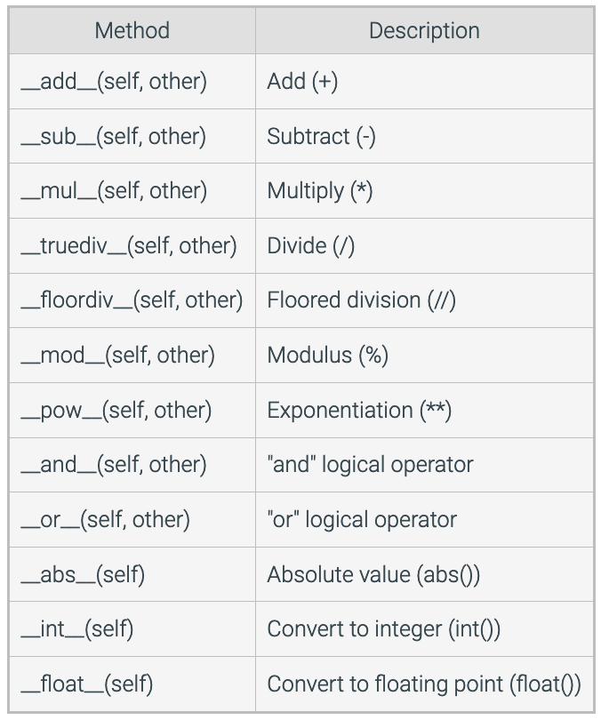
Operator Overloading
Built-in isinstance() function returns a Boolean if the object matches a given type
isinstance(object, class)
Returns True if object is an instance of class
Can be very helpful to ensure operating on correct data type
Methods for emulating numeric types

Slide 29
Operator Overloading
Class customization can redefine the functionality of built-in operators like +, -, and * when used with class instances through operator overloading
>>> class Number:
... def __init__(self, start):
... self.data = start
... def __sub__(self, other):
... return Number(self.data - other)
...
>>> x = Number(5) # Number.__init__(x, 5)
>>> y = x - 2 # Number.__sub__(x, 2)
>>> y.data # y is new Number instance
3

Slide 30
9.10 Memory Allocation and Garbage Collection

Slide 31
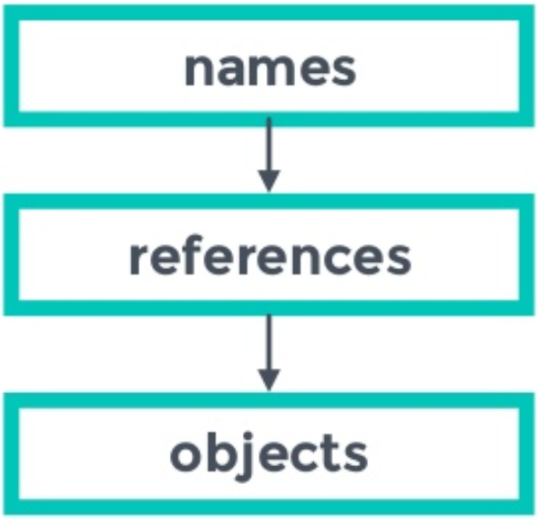


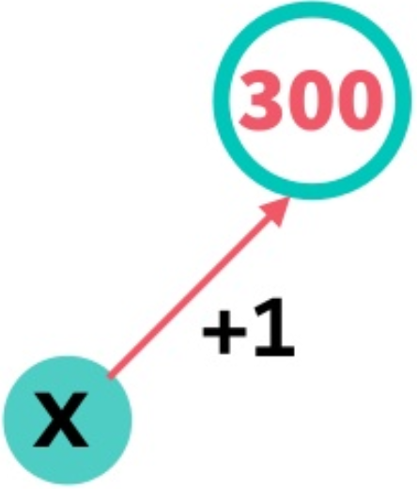
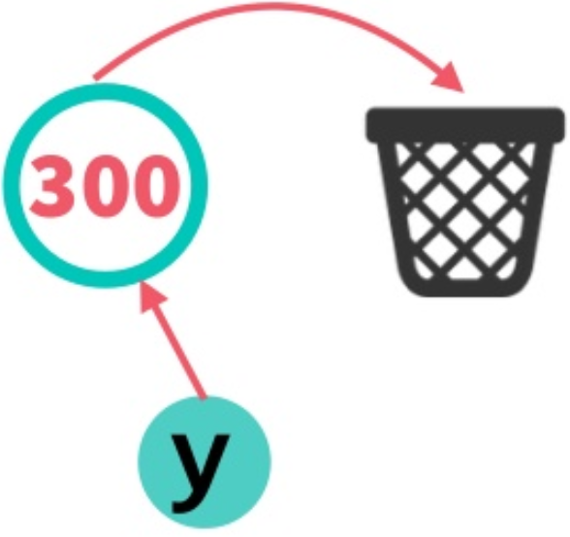
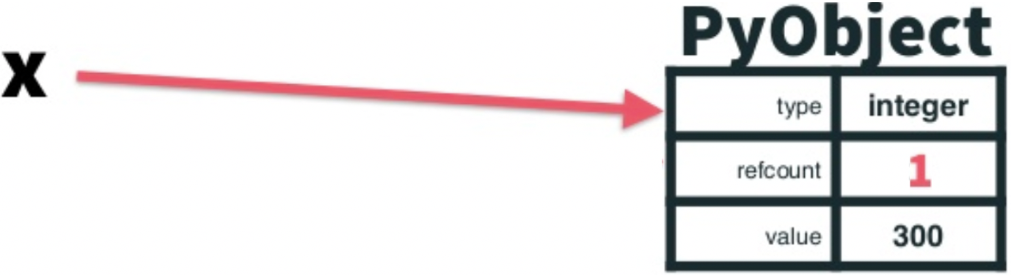

References and Reference Count
How are Python objects stored in memory?
A reference is a name of a container object pointing
at another object
A reference count is integer counter that represents
how many variables reference an object
When an object’s reference count is 0, that object is no longer referenced
The del statement doesn’t delete objects, but rather removes that name as a reference to that object and decrements the reference count by 1
references: 1
names references
references: 0

Slide 32
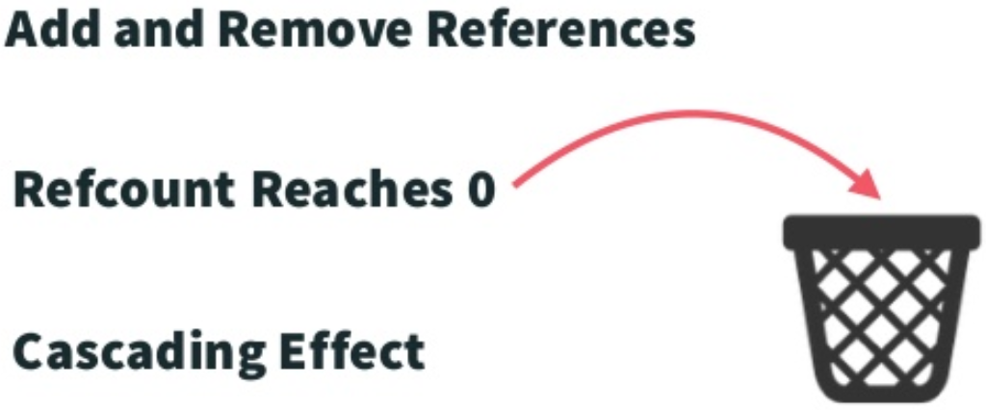
Garbage Collection
Garbage collection is a way for a program to automatically release memory when the object taking up that space is no longer in use
How does reference counting garbage collection work?
When reference count is 0, objects are immediately deleted

